Slide 1

The battle of neighborhoods Coursera – ibm Applied data science capstone
The Battle of Neighborhoods

Slide 2
Introduction: business problem
New York City is probably one of the most multiethnic places in the World. This great diversity of cultures is also reflected by NYC cuisine. The aim of this project is to find the optimal location for a new restaurant. Specifically, this report will be targeted to stakeholders interested in opening an Italian restaurant in New York City, USA. The factors we chosen to consider when deciding where open a new restaurant, are:
Market Places.
Competition in particular location.
Aiding places that make people come to restaurants like Gym, Pubs, Parks and more.
Population.
Menu of competitors.
We will use our data science powers to generate a few most promising neighborhoods based on these criteria. Advantages of each area will then be clearly expressed so that best possible final location can be chosen by stakeholders.

Slide 3
Data
For this project we need New York City neighborhoods Data, which will used to get to know about the various neighborhoods we are going to take into consideration,
Data Source: https://geo.nyu.edu/catalog/nyu_2451_34572
Geo-spatial data of NYC to get a better understanding of the neighborhoods in it and their corresponding locations in the Folium map would make certain things clear for the project. This will be achieved using the acquired data and visualize them using Choropleth maps.
Data Source: https://data.cityofnewyork.us/City-Government/Borough-Boundaries/tqmj-j8zm
Finally, the data going to be collected/acquired from the Foursquare API about the various restaurants in each neighborhood of New York city especially Italian cuisine, which will be used for acquiring the information regarding same for all the venues of each neighborhood.

Slide 4
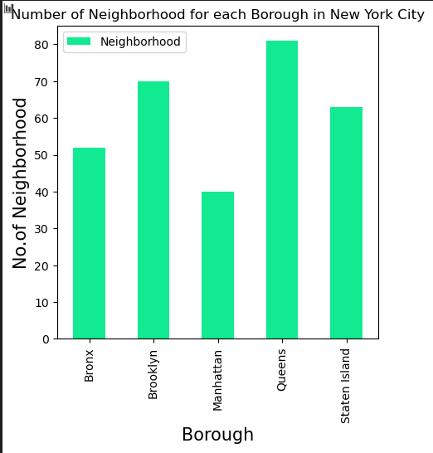
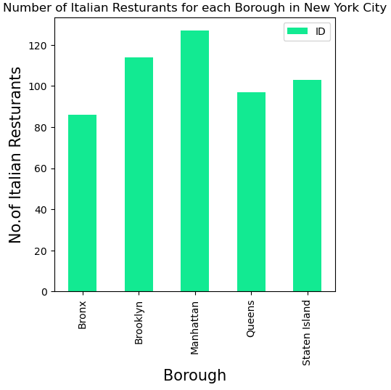
Exploratory Data Analysis

Slide 5
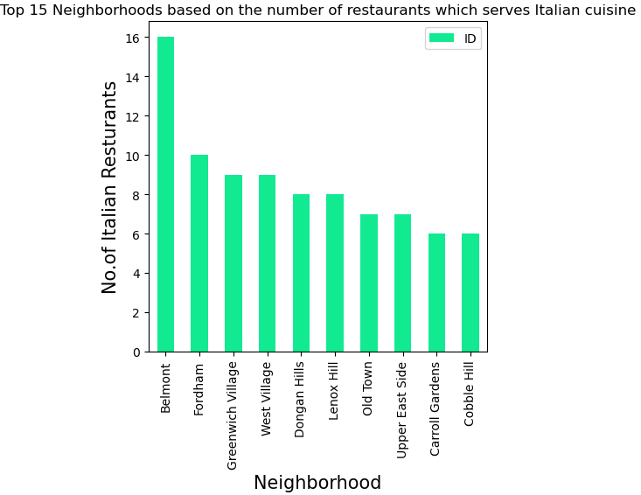
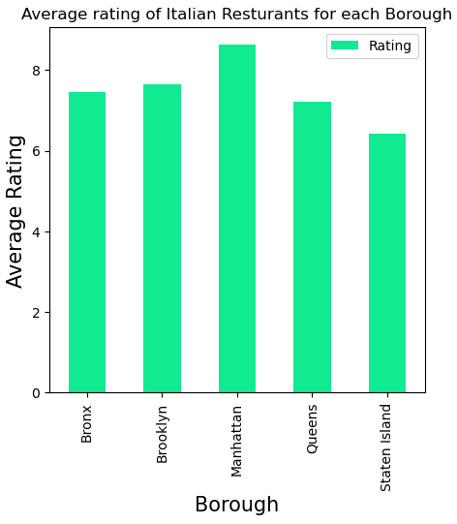
Exploratory Data Analysis

Slide 6
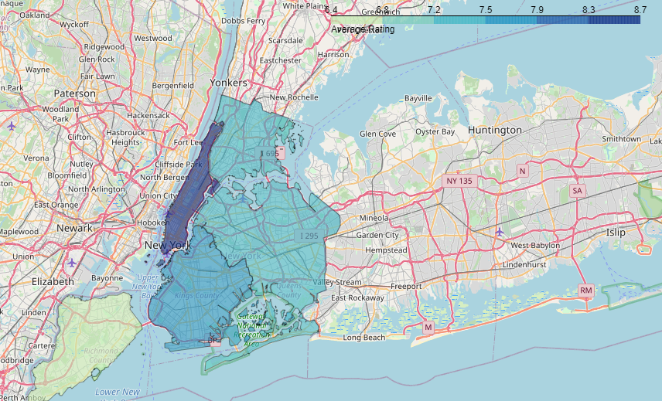
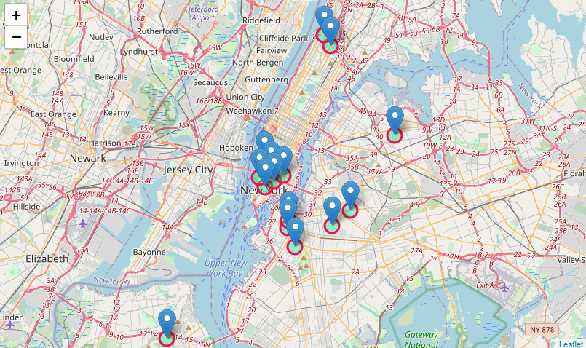
Results
Nr. Of Italian restaurants with a score higher than 9.0.
1. Manhattan: 8
2. Brooklyn: 5
3. Queens: 1
4. Staten Island: 1
5. Bronx: 0

Slide 7
Discussion & Conclusion
Basing on the Data Analysis and Visualization using Folium and Matplotlib, we have rendered various bar charts and two maps from which we can come to a better understanding of the business problem. According to what we have shown we can state the following sentences:
Manhattan is the borough formed by the lowest number of neighborhoods, but on the other hand have the highest number Italian restaurants. In addition, 8 of the 15 top-ranked (score higher than or equal to 9.0) Italian restaurants are placed in this borough. These ones are: Little Italy, Civic Center, Tribeca, Greenwich Village, Noho, Hamilton Heights, Central Harlem and West Village. Due to the high competition already established in these neighborhoods, we do not recommend to not chose Manhattan as the starting point for a business in Italian cuisine.
Brooklyn behave like Manhattan; 5 of the 15 top-ranked Italian restaurants are placed in this borough, thus, we do not recommend it as the favorite borough.
No top ranked restaurant is placed in Bronx, suggesting that a new opening should be a little bit risky.
The two more suitable borough are Staten Island and Queens. Due to its geographic position, maybe Queens is the right one. In fact, in this borough, just a neighborhood possessing an Italian restaurant with a score higher than 9 and the number of Italian restaurants is relatively lower than into the other boroughs. Anyway, Staten Island seems to be a good choice to, then a more detailed analysis in needed in order to state which is the best one.

